Slide 1
BIG DATA IN CLOUD COMPUTING

Slide 2
BIG DATA IN CLOUD COMPUTING
Big Data is used in decision making process to gain useful insights hidden in the data for business and engineering.
At the same time it presents challenges in processing
Cloud computing has helped in advancement of big data by providing computational, networking and storage capacity

Slide 3
BIG DATA
Data which is huge, difficult to store, manage and analyse through traditional databases is termed as “Big Data”
The volume and information captured from various mobile devices and multimedia by organizations is increasing every moment and has almost doubled every year.
This sheer volume of data generated can be categorized as structured or unstructured data that cannot be easily loaded into regular relational databases.

Slide 4
This big data requires pre-processing to convert the raw data into clean data set and made feasible for analysis
Healthcare, finance, engineering, ecommerce and various scientific fields use these data for analysis and decision making.
The advancement in data science, data storage and cloud computing has allowed for storage and mining of big data

Slide 5
Sources of Big Data: Such massive volume of data comes from countless sources.
Smartphones and social media posts; sensors, such as traffic signals and utility meters; point-of-sale terminals; consumer wearables such as fit meters and electronic health records

Slide 6
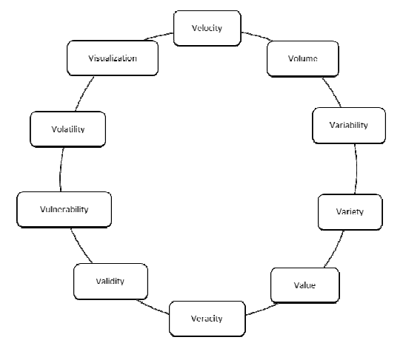
The characteristics of big data

Slide 7
V’s of Big Data
Volume – Refers to incredible amount of data generated each second from different sources such as social media, cell phones, cars, credit cards, M2M sensors, photographs and videos which would allow users to data mine the hidden information and patterns found in them.

Slide 8
V’s of Big Data
Velocity - Refers to the speed at which data is being generated, transferred, collected and analyzed
Data generated at an ever-accelerating pace must be analyzed and the speed of transmission, and access to the data must remain instantaneous to allow for real-time access to different applications that are dependent on these data.

Slide 9
V’s of Big Data
Variety – Refers to data generated in different formats either in structured or unstructured format
Structured data such as name, phone number, address, financials, etc can be organized within the columns of a database
This type of data is relatively easy to enter, store, query, and analyse
Unstructured data which contributes to 80% of today’s world data are more difficult to sort and extract value
Unstructured data include text messages, audio, blogs, photos, video sequences, social media updates, log files, machine and sensor data

Slide 10
V’s of Big Data
Variability – Refers to the high inconsistency in data flow and its variation during peak period
The variability is due to different data types and sources
Variability can also refer to the inconsistent speed at which big data is ingested into the data stores.

Slide 11
V’s of Big Data
Value – Refers to the hidden value discovered from the data for decision making
Substantial value can be found in big data, including understanding your customers better, targeting them accordingly, optimizing processes, and improving machine or business performance.

Slide 12
V’s of Big Data
Veracity - Refers to the quality and reliability of the data source
Its importance is in the context and the meaning it adds to the analysis
Knowledge of the data's veracity in turn helps in better understanding the risks associated with analysis and business decisions based on data set

Slide 13
V’s of Big Data
Validity - Refers to the accuracy of the data been collected for its intended use
Proper data governance practices need to be adopted to ensure consistent data quality, common definitions, and metadata.

Slide 14
V’s of Big Data
Vulnerability – Refers to the security aspects of the data been collected and stored.

Slide 15
V’s of Big Data
Volatility – Refers to how long data is valid and the duration for which it needs to be stored historically before it is considered irrelevant to the current analysis

Slide 16
V’s of Big Data
Visualization – Refers to data being made understandable to nontechnical stakeholders and decision makers
Visualization is the creation of complex graphs that transforms the data into information, information into insight, insight into knowledge, and knowledge into advantage for decision making

Slide 17
BIG DATA CLASSIFICATION
Big data is classified based upon its source, format, data store, frequency, processing methodology and analysis types

Slide 18
BIG DATA CLASSIFICATION
Analysis Type - Whether the data is analyzed in real time or batch process. Banks use real time analysis for fraud detection whereas business strategic decisions can make use of batch process.
Processing Methodology - Business requirements determine whether predictive, ad-hoc or analytical needs to be used

Slide 19
BIG DATA CLASSIFICATION
Data Frequency - Determines how much of data is ingested and the rate of its arrival. Data could be continuous as in real-time feeds and also time series based.
Data Type - It could be historical, transactional and real-time such as streams

Slide 20
BIG DATA CLASSIFICATION
Data Format -
Structured data such as transactions can be stored in relational databases.
Unstructured and semi-structured data can be stored in NoSQL data stores
Formats determine the kind of data stores to be used to store and process them.

Slide 21
BIG DATA CLASSIFICATION
Data Source - Determines from where the data is generated like social media, machines or human generated.
Data consumers - List of all users and applications which make use of the processed data

Slide 22
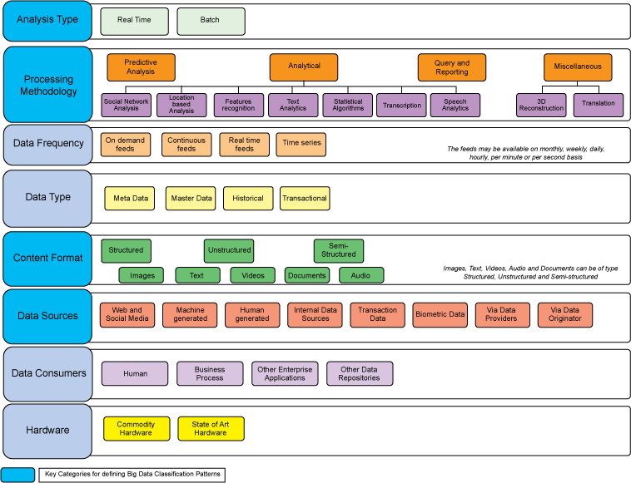
BIG DATA CLASSIFICATION

Slide 23
RELATIONSHIP BETWEEN THE CLOUD AND BIG DATA
Big data and Cloud computing are closely related to each other
Big data is more about extracting value while cloud computing focuses on scalable, elastic, on-demand and pay-per-use self-service models
Big data requires massive on-demand computation power and distributed storage while cloud computing seamlessly provides elastic on-demand integrated computer resources, required storage and computing capacity to analyze big data

Slide 24
RELATIONSHIP BETWEEN THE CLOUD AND BIG DATA
Cloud computing also offers the distributed processing for scalability and expansion through virtual machines to meet the requirements of exponential data growth
It has resulted in the expansion of analytical platforms that are designed to address the demands of users, especially large data-driven companies in providing contextual analyzed data out of all the stored information
This has resulted in service providers like Amazon, Microsoft and Google in offering big data systems in cost efficient manner to capture data and adding analytics to offer proactive and contextual experiences

Slide 25
RELATIONSHIP BETWEEN THE CLOUD AND BIG DATA
Recently Cloud analytics or Analytics as a Service (AaaS) are provided to clients on demand
Analytics as a Service (AaaS) provides subscription-based data analytics software and procedures through the cloud for a fast and scalable way to integrate data in semi-structured, unstructured and structured format, transform and analyze them.

Slide 26
RELATIONSHIP BETWEEN THE CLOUD AND BIG DATA
The relationship between big data and cloud computing follows input, processing and output model as shown in next slide
The input is the big data obtained from various data sources such a cellular and other smart devices in either structured, unstructured or semi-structured format.
This voluminous data is cleaned and then stored using Hadoop or other data stores
The stored data is in turn processed through cloud computing tools and techniques for providing services.
Processing steps includes all the tasks required to transform input data.
Output represents the value obtained after data is being processed for analysis and visualization

Slide 27
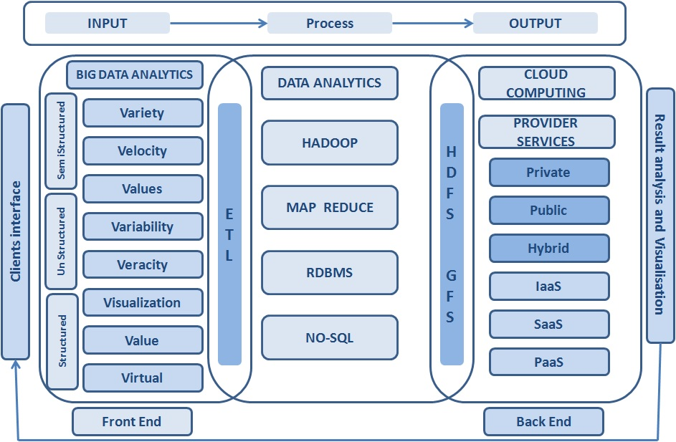

Slide 28
IoT , Big Data and Cloud Computing
Internet of Things (IoT) is one of the common factors between Cloud computing and big data
Data generated from IoT devices is massive and needs to be analyzed in real time
Cloud providers allow data to be transmitted over internet or via lease lines and maintain them in data stores.

Slide 29
IoT , Big Data and Cloud Computing
Cloud computing techniques and tools are then used on the big data stored in cloud for filtering and analysis
It provides a pathway for the data to navigate, store and be analyzed
Cloud computing provides common platform for IoT and big data
Cloud computing, IoT and Big data have complementary relationship
IoT is the source of the data and big data is an analytical technology platform of the data

Slide 30
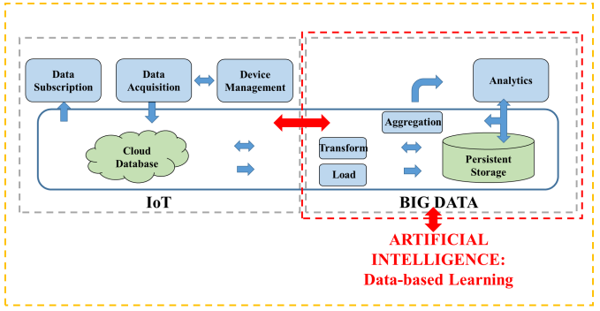
IoT , Big Data and Cloud Computing

Slide 31
Big Data TOOLS AND TECHNIQUES
Big data applications use various tools and techniques for processing and analysis of the data.
Some of them are listed in next slide

Slide 32
Big Data TOOLS AND TECHNIQUES
Tools/Techniques | Description | Developed by | Written in
HDFS | Redundant and Reliable massive data storage | Introduced by Google | Java
Map Reduce | Distributed data processing framework | Introduced by Google | Java
YARN | Cluster resource management framework | Apache | Java
Storm | Stream based task parallelism | Twitter | Clojure
Spark | Stream based data parallelism | Berkeley | Scala
Map Reduce | Java API. | Introduced by Google | Java
Pig | Framework to run script language Pig Latin | Yahoo | Java
Hive | SQL-like language HiveQL | Facebook | Java
HCatalog | Relational table view of data in HDFS | Apache | Java
HBase | NoSQL column oriented | Google’s BigTable | Java
Casandra | NoSQL column oriented | Facebook | Java
Flume | Import/Export unstructure or semi structure data into HDFS. Data ingestion into HDFS. | Apache | Java
Sqoop | Tool designed for efficiently transferring bulk structured data (RDBMS) into HDFS and vies versa. | Apache | Java
Kafka | Distributed publish-subscribe messaging system for data integration | LinkedIn | Scala
Ambari | Web based cluster management UI | Hortonworks | Java
Mahout | Library of machine learning algorithms | Apache | Java
Oozie | Define collection of jobs with their execution sequence and schedule time | Apache | Java
Sentry | Role based authorization of data stored on an Apache Hadoop cluster. | Cloudera | Java
Zookeeper | Coordination service between hadoop ecosystems. | Yahoo | Java

Slide 33
CASE STUDIES
Redbus
Redbus is an online travel agency for bus ticket booking in India
Redbus decided to use Google data infrastructure for data processing and analysis in order to improve customer sales and management of the ticket booking system.
Google BigQuery enabled RedBus to process massive amounts of booking and inventory data within seconds

Slide 34
Applications that reside on multiple servers continuously streams customer searches, seat inventory and booking information to centralized data collection system
This massive data collected is then sent to BigQuery, which runs complex queries and within seconds provide answers to various analytical queries such as how many times a customer searched for a destination and found very few bus services available, any technical issues that might arise during booking and notify the necessary team
This whole infrastructure helped RedBus to fix glitches quickly, minimize lost sales and improve customer service

Slide 35
CASE STUDIES
Nokia mobile company
Nokia mobile phones are been used by many people for telecommunication
In order to better understand their user interactions and improve the user experience with their phones, Nokia gathers large amount of data from mobile phones in petabyte scale
For deriving business decision strategies and get a holistic view of user interaction, the company implemented Hadoop data warehouse as an infrastructure that could store this daily petabyte of unstructured data collected from mobile phones in use, services, log files, and other sources

Slide 36
With this setup, Nokia was also able to perform complex processing and computation on their massive data and gain more analytical insights on their user interactions such as ‘Which feature did they go to after this one?’ and ‘Where did they seem to get lost?
It has also enabled them to create wide variety of applications such as 3D digital maps that incorporate traffic models that understand speed categories, recent speeds on roads, historical traffic models, elevation, ongoing events, and more

Slide 37
Challenges
Big data are huge data sets that are very complex
The data generated is highly dynamic and this further adds to its complexity
The raw data must be processed in order to extract value from it
This gives rise to challenges in processing big data and business issues associated with it

Slide 38
Volume of the data generated worldwide is growing exponentially
Almost all the industries such as healthcare, automobile, financial, transportation etc rely on this data for improving their business and strategies
For example, Airlines does millions of transactions per day and have established data warehouses to store data to take advantages of machine learning techniques to get the insight of data which would help in the business strategies.
Public administration sector also uses information patterns from data generated from different age levels of population to increase the productivity

Slide 39
Cloud computing has been used as a standard solution for handling and processing big data.
Despite all the advantages of integration between big data and cloud computing, there are several challenges in data transmission, data storage, data transformation, data quality, privacy.

Slide 40
Data Transmission
Data sets are growing exponentially. Along with the size, the frequency at which these real-time data are transmitted over the communication networks has also increased.
Healthcare professions exchange health information such as high-definition medical images that are transmitted electronically while some of the scientific applications may have to transmit terabytes of data files that may take longer to traverse the network
In case of streaming applications, the correct sequence of the actual data packets is as critical as the transmission speed.
Cloud data stores are used for data storage however, network bandwidth, latency, throughput and security poses challenges

Slide 41
Data Acquisition and Storage
Data acquisition is the process of collecting data from disparate sources, filtering, and cleansing data before it can be stored in any data warehouses or storage systems
While acquiring big data,the main characteristics that pose a challenge are the sheer volume, greater velocity, variety of the big data.
This demands more adaptable gathering, filtering, and cleaning algorithms that ensure that data are acquired in more time-efficient manner.
Data once acquired, needs to be stored in big capacity data stores which must provide access to these data in a reliable way

Slide 42
Security and Privacy
Maintaining the security of the data stored in the cloud is very important
Sensitive and personal information that is kept in the cloud should be defined as being for internal use only, not to be shared with third parties
This would be a major concern when providing personalized and location-based services

